Slide 1
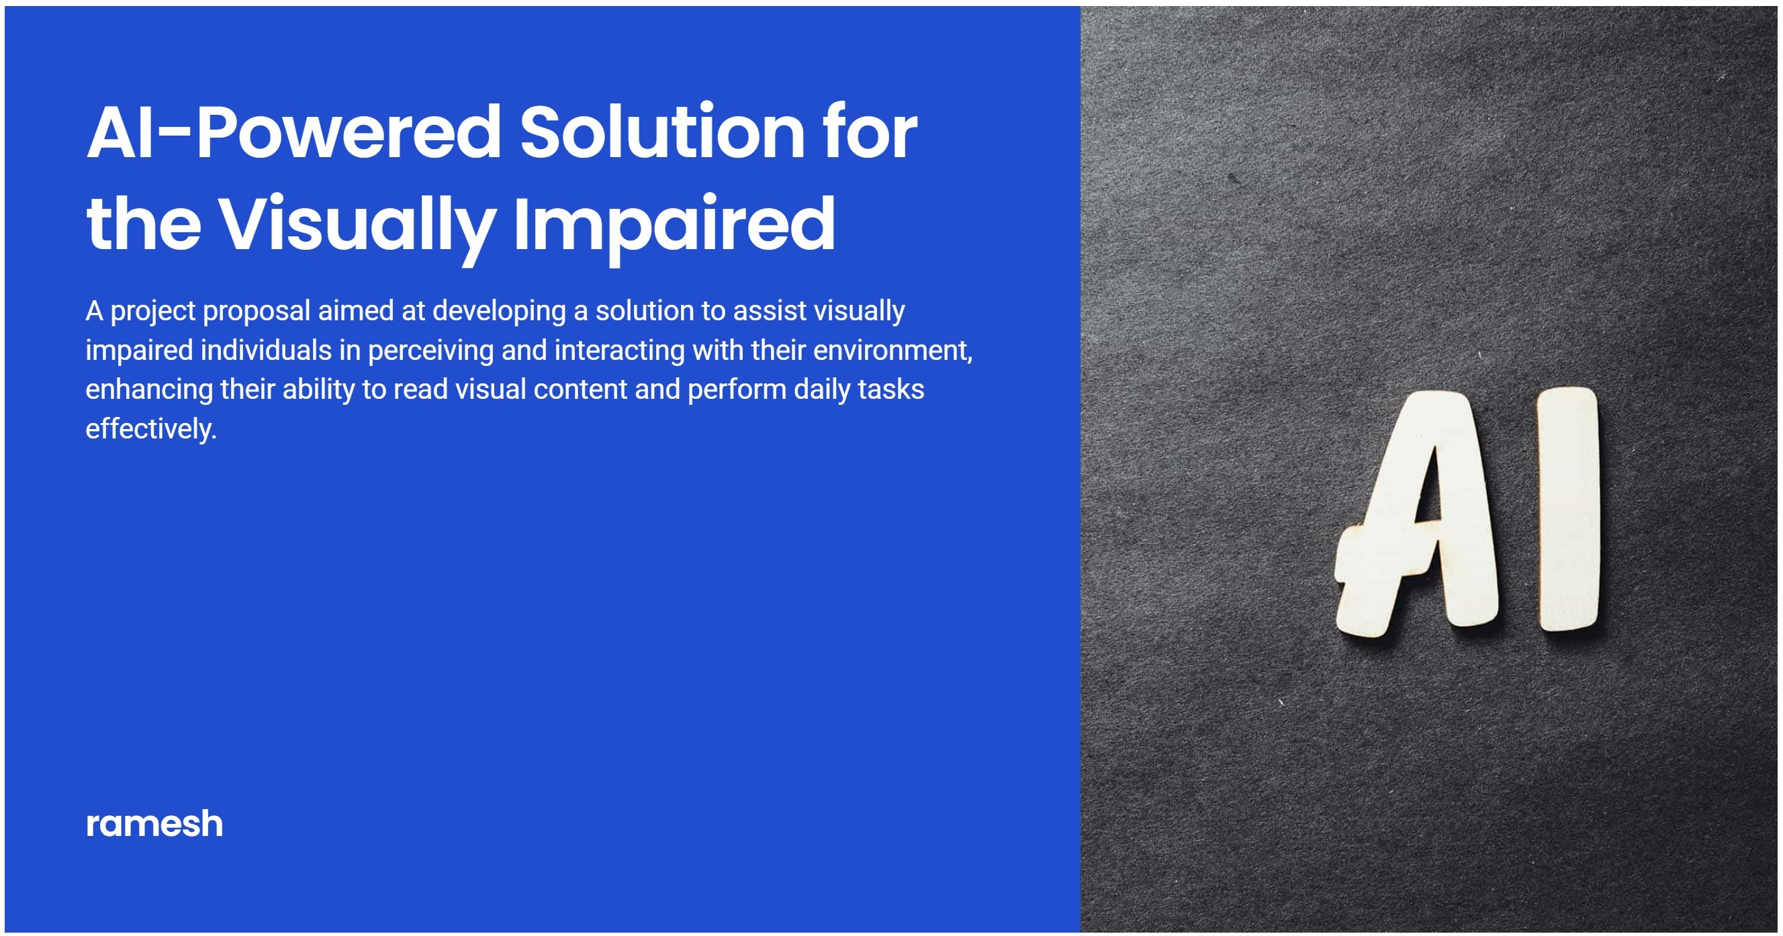

Slide 2






Building Al Powered Solution for Assisting Visually lmpoired Individuols
Table of Contents
Problem Statement
Discusses the challenges faced by visually impaired individuals and the need for innovative solutions.
Project Objectives
Oullines the goals of the project aimed at developing AI solutions for assisting visually impaired individuals.
Task Overview
Provides an overview of the tasks involved in the project from inception to completion.
Feature 1: Reol- Time Scene Understonding
Details the capability of 1he solution to interpret and analyze the surrounding environment in real time.
Feoture 2: Text-to- Speech Conversion for Visual Content
Explains how the system converts visual content into audible formats to assist users.
Feoture 3: Object and Obstacle Detection for Safe Novigotion
Describes the technology used to detect obstacles and objects to ensure safe movement for users.
@ Feoture 4: Personolized Assistance for Doily Tosks
Focuses on how 1he solution provides tailored assistance 1o users in their daily activities.
Implementation Requirements
Lists the necessary resources and prerequisites for implementing 1he project.
Technology Stock
Outlines the lechnologies and tools that will be ulilized in the development of the solution.
@ Expected Outcomes and Future Directions
Discusses the anticipated results of lhe project and potential future enhancements.

Slide 3
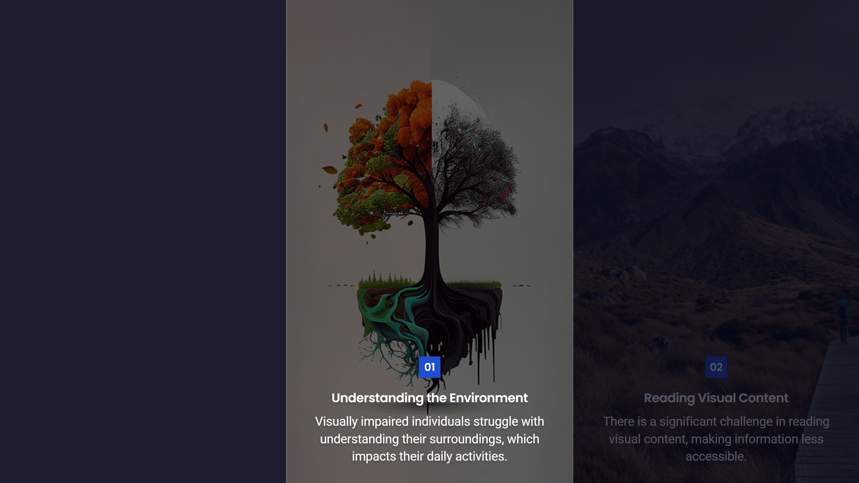

Slide 4

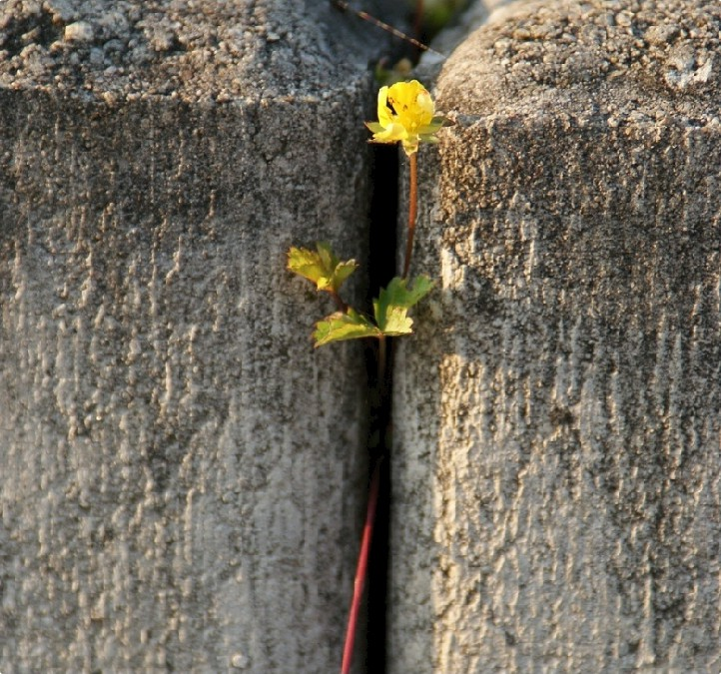

Project Objectives
Enhancing Accessibility Through Generative AI
Focus on Accessibility
Create an application that enhances independence and safety.
Leverage Generative AI
Aim to improve the interaction of visually impaired individuals with their surroundings.
Adaptability
Ensure the solution is personalized to meet individual user needs a

Slide 5
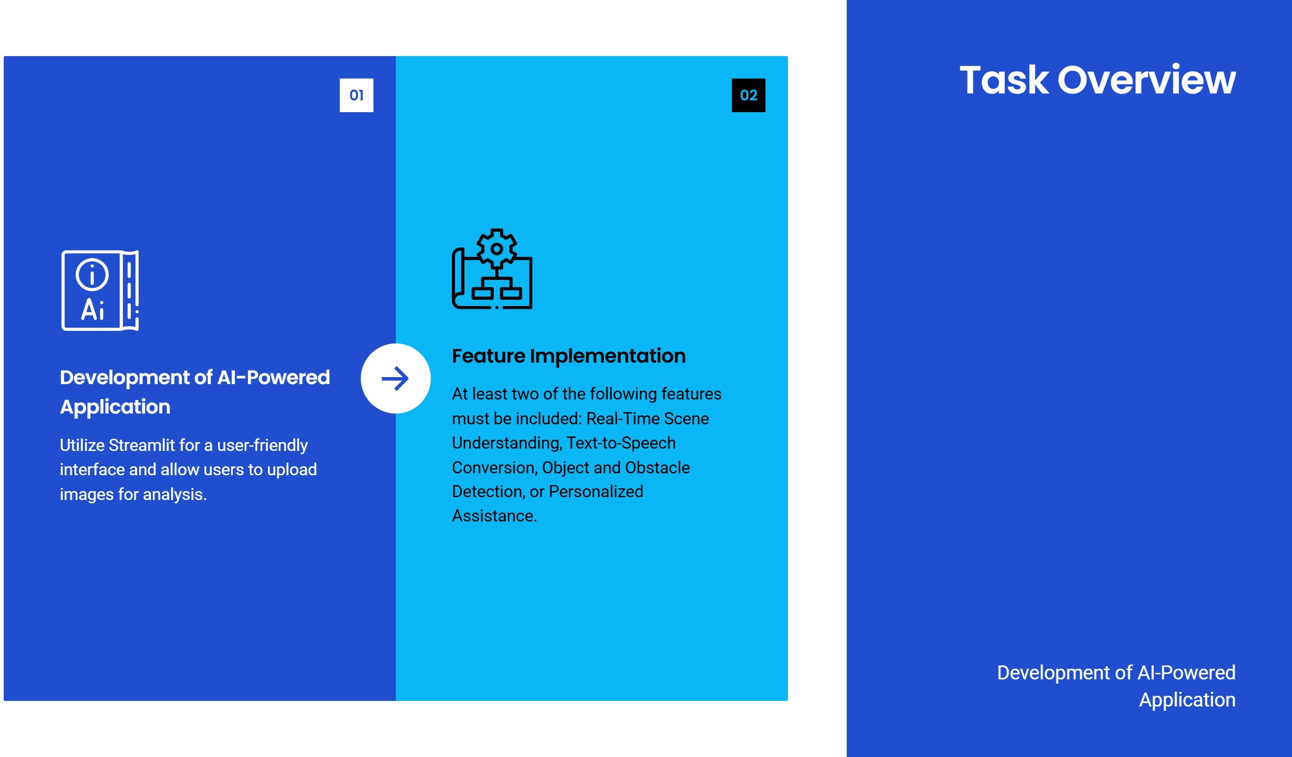

Slide 6
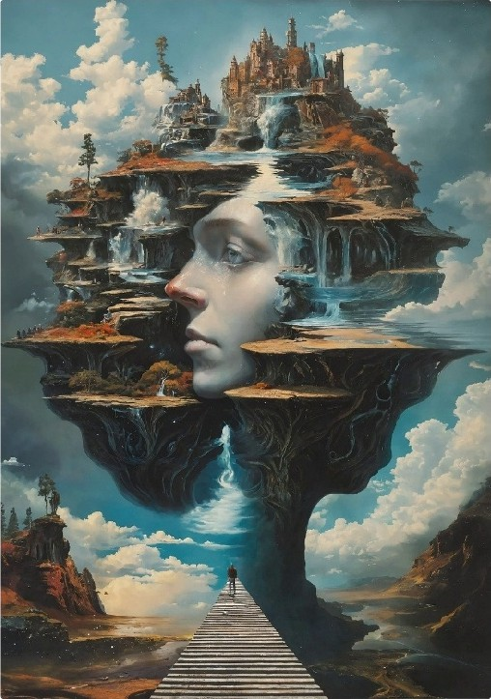

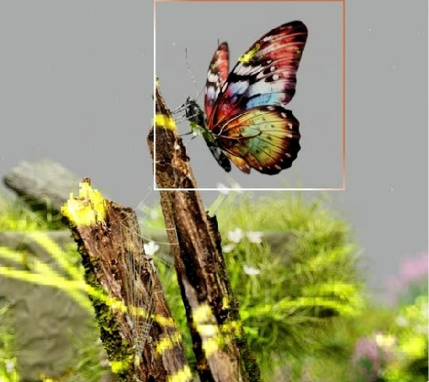
Feoture 1: Reol-Time Scene Understonding
Descriptive Text Generation
Generate descriptive textual output from uploaded images.
Image Analysis Techniques
Utilize image analysis to interpret scenes.
Understanding Surroundings
Enable users to effectively understand the content of their surroundings.
Natural Language Generation
Apply natural language generation to create readable descriptions.

Slide 7
Feature 2: Text- to-Speech Conversion for Visual Content
Functionality of Text-to-Speech Conversion
Extract text from images using OCR (Optical Character Recognition) and convert the
extracted text into audible speech
I
i
n
Enhancing Accessibility Through Technology

Slide 8


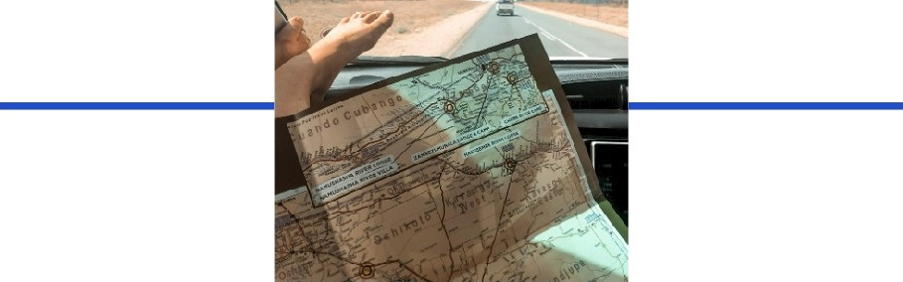


Feoture 3: Object ond Obstacle Detection for Sofe Novigotion
Enhancing User Safety and Navigation Confidence
Functionality of Detection
Identify and highlight objects or obstacles within images to improve situational awareness.
Safe ’Navigation
lmpoct on User Sofety
Enhances the ability to avoid hazards, significantly contributing to user safety.
Confidence in
Navigation
Improves overall confidence in navigating environments by reducing the risk of accidents.
Provides situational awareness crucial for safe navigation through different environments.

Slide 9
Personolized Assistance for Doily Tosks
Enhancing Daily Activities with Tailored Guidance

Slide 10

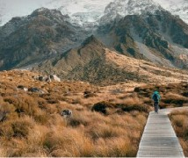
Implementation Requirements
Technologies and Development Environment
Technologies Needed
Utilize Langchain for language processing, Streamlit for the application interface, and Google Generative AI for enhanced AI capabilities.
Development Environment
Set up necessary libraries and frameworks to support application development.

Slide 11
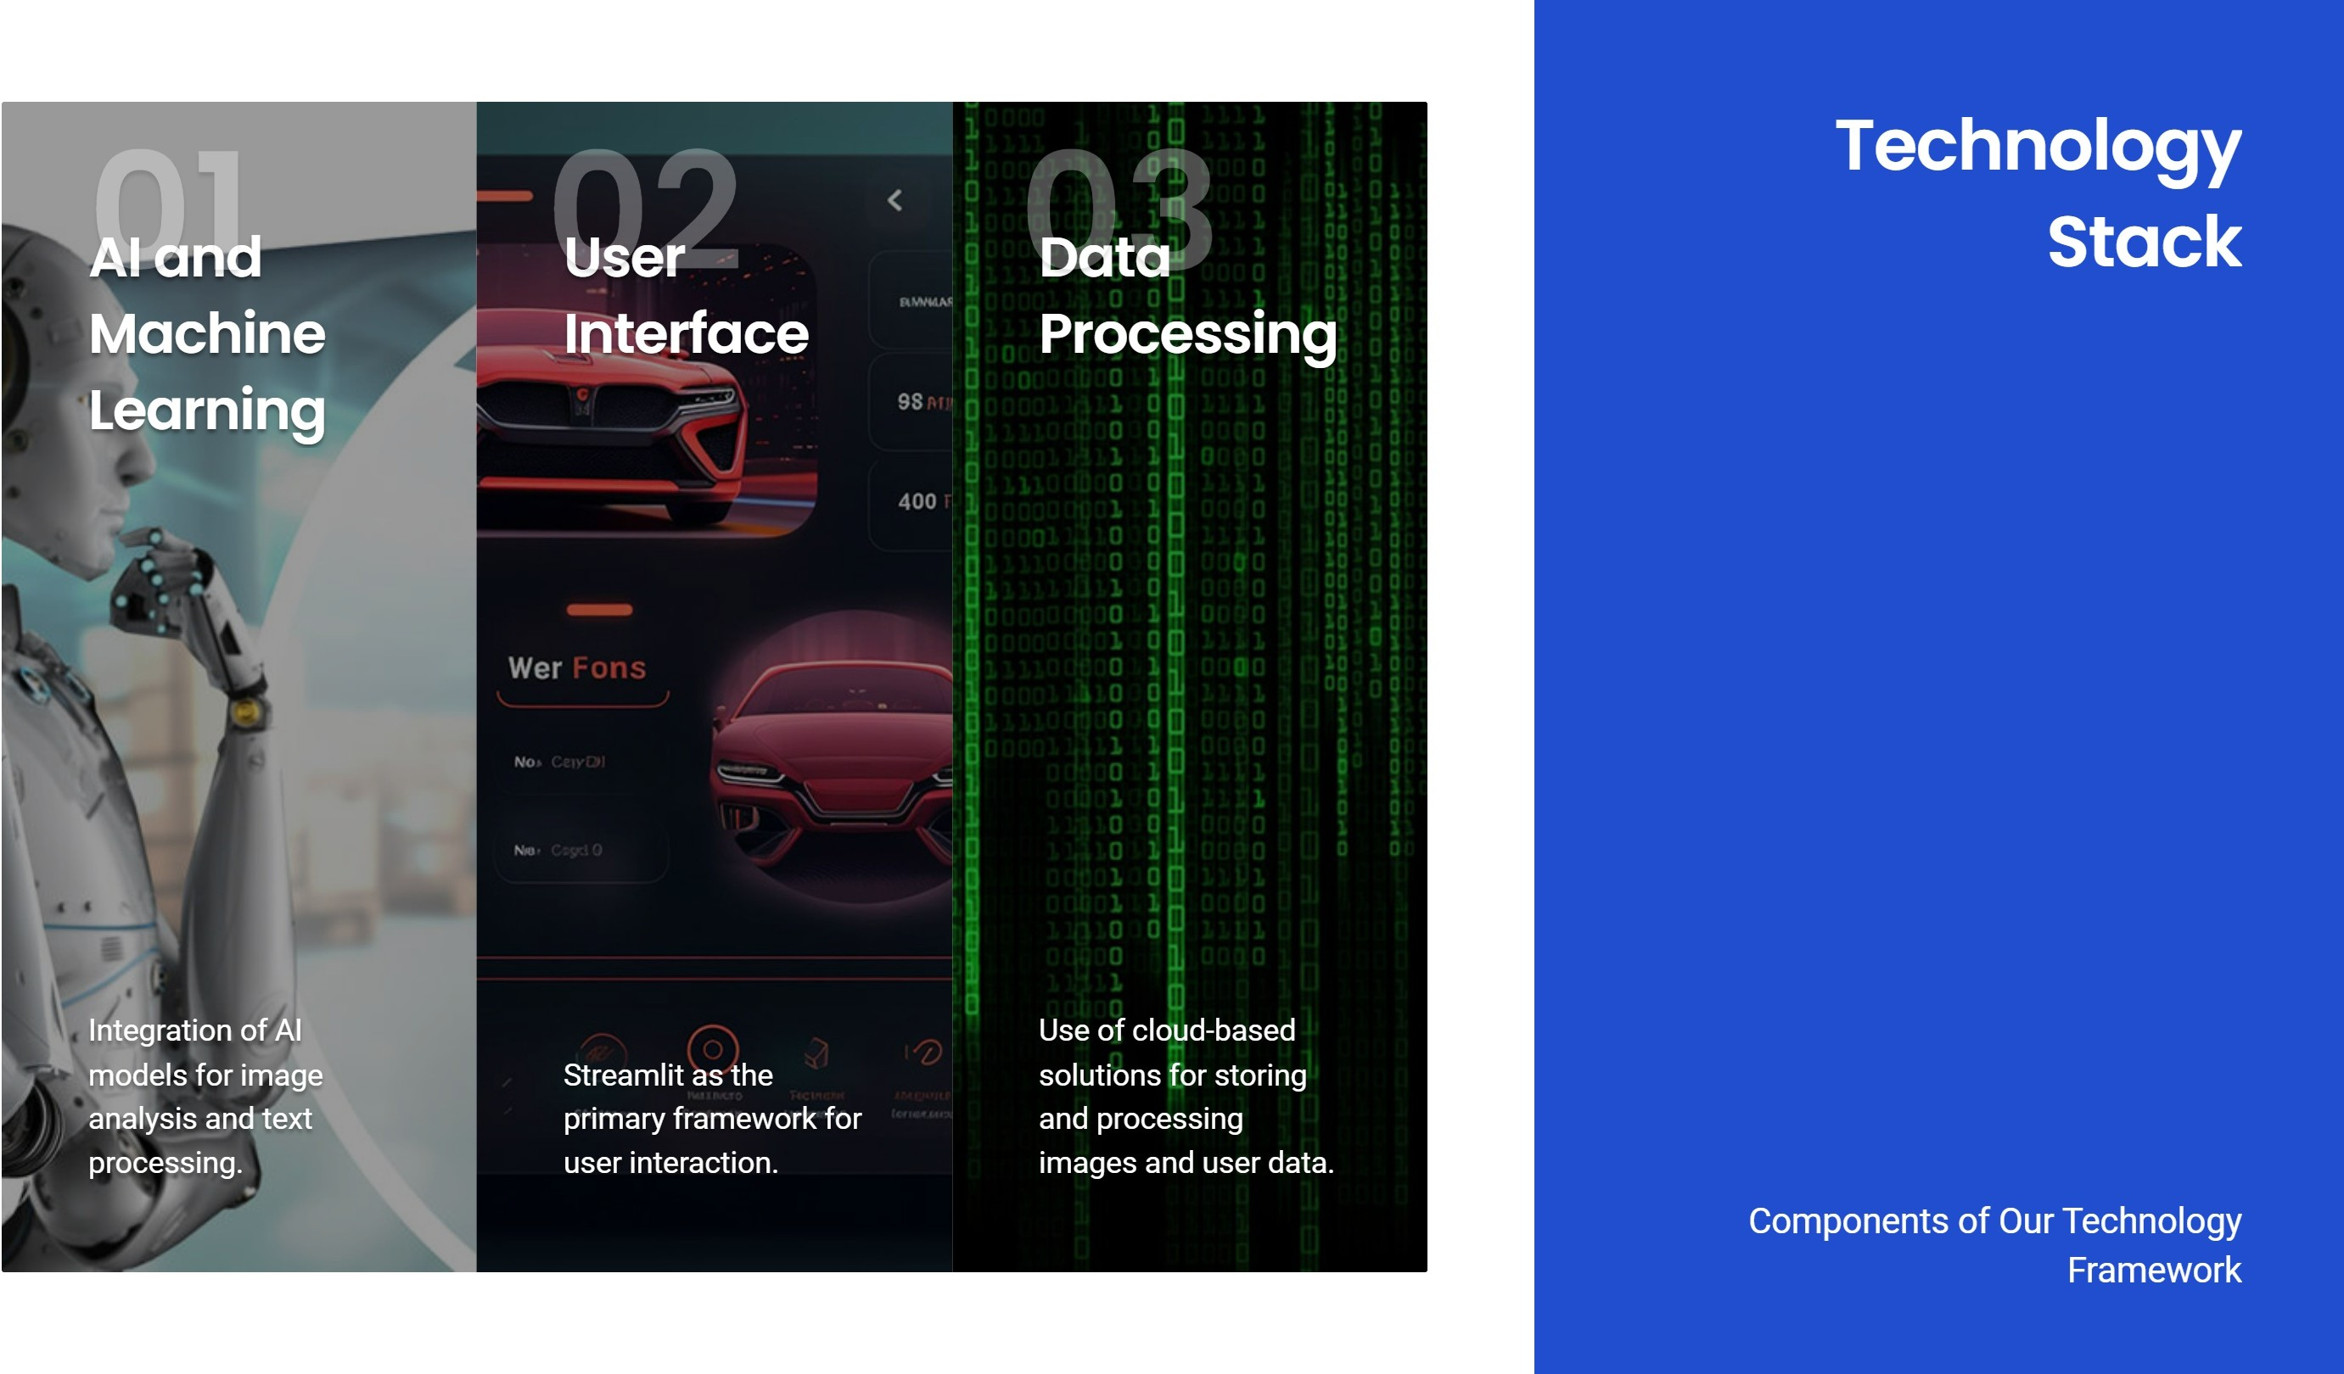

Slide 12
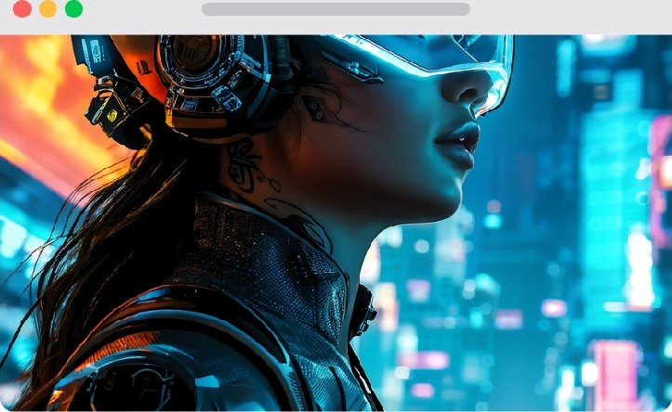


Expected Outcomes ond Future Directions
Enhancing Independence and Technological Advancements
User Empowerment
Enhanced independence and interaction with the environment for visually impaired individuals.
Future Enhancements
Continuous improvement of AI models for better accuracy and expansion of features based on user feedback and technological advancements.
Broader Impact
Potential applications in various fields beyond personal assistance, such as education and public services.

